Slide 1
CH.5 FINANCIAL MANAGEMENT

Slide 2
CO TO BE LEARNED IN CHAPTER
Explain the government rules and regulations related to financial management, Industrial safety acts.

Slide 3
CONTENT OF CHAPTER
Financial Management- Objectives & Functions
Capital Generation & Management • Types of Capitals - Fixed & Working • Sources of raising Capital - Features of Short term, Medium Term & Long Term Sources
Budgets and accounts • Types of Budgets • Fixed & Variable Budget - Concept • Production Budget - Sample format • Labour Budget - Sample format • Profit & Loss Account & Balance Sheet - Meaning, sample format, meaning of different terms involved.
Meaning & Examples of
• Excise Tax • Service Tax • Income Tax • Value Added Tax • Custom Duty

Slide 4


FINANCE
Finance is a field that deals with the allocation of assets and liabilities over time.
It is the effective procurement of funds and its effective utilization.

Slide 5

FINANCIAL MANAGEMENT
Financial Management is the study of relationship between the raising of finance and deployment of finance.
Financial Management refers to the application of skills in procurement , use and control of finance.
Nothing but effective management of funds.

Slide 6
FINANCIAL MANAGEMENT
EXECUTIVE FINANCE FUNCTIONS
ROUTINE FINANCE FUNCTIONS
Capitalization decision
Capital structure design
Management of Fixed assets
Managing of working Capital
Management of Cash flow
Management of Earnings
Control of cash
Safety of documents
Record keeping
Management reporting

Slide 7

CAPITAL
It’s the measure of amount of resources of an enterprise.
Capital refers to financial assets as cash and funds held in deposit accounts, as well as the tangible machinery and production equipment used in environments such as factories and other manufacturing facilities.
capital includes facilities, such as the buildings used for the production and storage of the manufactured goods.

Slide 8

CAPITAL IS REQUIRED FOR…
Buy plant,machinary,equipments
Procure raw materials
Manufacturing of products- wages, power,tools, expenses
Promote sales- advertising and promotions
Dispatching of goods- packing of goods and transportation.

Slide 9
TYPES OF CAPITAL
CAPITAL
FIXED
SEASONAL WORKING CAPITAL
WORKING
PERMANENT
WORKING CAPITAL

Slide 10
FIXED CAPITAL
Also called “Block Capital”
Required in the starting phase of enterprise
Large amount of capital is required
It is the permanent asset.
Required for:
  Land
  Machinary, equipments and tools.
  Plant setup.
  Infrastructure and buildings
  Electric and water supply
  Furniture
  Office setup.
  Intellectual Property

Slide 11
WORKING CAPITAL
Required for day to day working of enterprise.
Also called “Circulating Capital”
Short term use of funds.
Includes:
  Material purchasing
  Maintenance cost
  Payments/salary
  Advertisement expenses
  Transportation costs
  Cost of facilities

Slide 12
WORKING CAPITAL
Material purchased
Product manufactured
Product sold
Cash
Working Capital

Slide 13
TYPES OF WORKING CAPITAL
PERMANENT WORKING CAPITAL
Permanent in nature for month or year
SEASONAL WORKING CAPITAL
Expenditure due to seasonal happenings
Ex.: Bonus pays,Special functions,Accidental charges, Special advertisement campaigns,conferences,etc.
Ex.:Payments,salary,Min stock of materials, electric and telephone bills
Minimum capital required for day to day working
Unpredictable incidents happens affecting the capital utilization

Slide 14
FIXED CAPITAL
Required in starting phase of industry
One time activity
Permanent Asset of firm
Called as Block Capital
Not varying i.e. fixed
Ex.: Land,Machinary, equipments and tools,Plant setup.,Infrastructure and buildings,Electric and water supply,Furniture,Office setup,Intellectual Property
WORKING CAPITAL
Required in running phase of industry
Continuous activity
Consumed in day to day working
Called as circulating capital
Variable
Ex.:Material purchasing,Maintenance cost,Payments/salary,Advertisement expenses,Transportation costs,Cost of facilities

Slide 15
SOURCES OF RAISING CAPITAL
INTERNAL
Inherited personal funds
Depreciation provisions
Retained equity Earnings
Deffered taxation

Slide 16
SOURCES OF RAISING CAPITAL
EXTERNAL
Long Term
Loans
Shares
Medium term
Loans
Short term
Financial Institutions
Debentures
Savings
Public Deposits
Corporate Bonds
Hire purchase
Equipment Lease
Trade credit
Bank Credit
Customer advances
Industrial development banks
Industrial financial corp
Insurance companies
State financial companies

Slide 17
EQUIPMENT LEASE :
Equipment is used on rental payment on lease basis.
Way to acquire high cost equipments.
This capital can be used somewhere else.
HIRE PURCHASE:
When buyer is unable to pay the full purchase price; he pays an initial deposit to the supplier/finance house to get the equipment /machinery/item.
Hire purchaser then pays regularly monthly or period wise payments.
Interest rates are high.
Finance Equipment Lease:
Contract between :
1.Lessor-Financer
Equipments owned by lessor
2.Lessee-One who acquires equipments or goods
Lessee is responsible for maintenance and everything.

Slide 18
INTERNAL SOURCES OF FINANCE
Inherited personal funds
Depreciation provisions
Retained equity Earnings
Deferred taxation
Own investment
Provision against “ageing of machine”
Reinvestment of shareholders in company again
Other sources of own investment
Capital kept aside at the starting phase
Due to this no urgency if machine breakdown or repair or replacement
This happens if shareholders are motivated
Postponement of Tax liability

Slide 19
SHARE MARKET
Shares is the investment in Joint stock Companies.
Also called “Stock market” or “Equity market”
Trading of shares i.e. purchase and sell.
BSE(Bombay Stock Exchange),PSE (Pune Stock Exchange),JSE ( Jaipur Stock Exchange) ,etc.

Slide 20
SHARES
PREFERNCE SHARES
Some part of profit earned by company is reinvested and the remaining is given to the shareholder ; called as “Dividend”
Cumulative Preference shares
ORDINARY SHARES
Called as Equity shares
BONUS SHARES
When large amount of profit which is accumulated with the company
RIGHTS SHARES
If company wishes to raise more cash it can make a right issue
Non Cumulative Preference shares
Each share carries one vote
Voting rights are limited
Dividend is not fixed and depends upon policy by directors.
Company converts this profit into ordinary share capital
Distributed proportionately to all shareholders
Made available to existing shareholders at concession

Slide 21


BUDGETS AND ACCOUNTS
BUDGETS:
Financial plan of next year
Instrument for planning future activities related to finance.
Statement which tells the future inflow and outflow of money in upcoming year

Slide 22


BUDGETARY CONTROL
When budgets are used as a tool for planning and controlling the capital ,is called as Budgetary control
It is the comparison between actual operations and expected performance in the budget; and hence making the necessary adjustments in performance.

Slide 23
TYPES OF BUDGET
BASED ON FLEXIBILITY
BASED ON MECHANISM
BASED ON FUNCTIONS
Variable budget
Fixed budget
Performance budgeting
Appropriation budgeting
Zero base budgeting

Slide 24
FUNCTIONAL BUDGET
Production Budget
Cash Budget
Labour Budget
Material Budget
Sales Budget
Capital Expenditure budget
Financial budget
Master budget

Slide 25
Production Budget
Production Budget is based upon the sales budget.
Sales budget tells what quantity is to be produced hence gives output required / month.
Hence production budget isprepared to meet the sales budget.
Contains Quantity to be produced month wise or quarter wise.

Slide 26
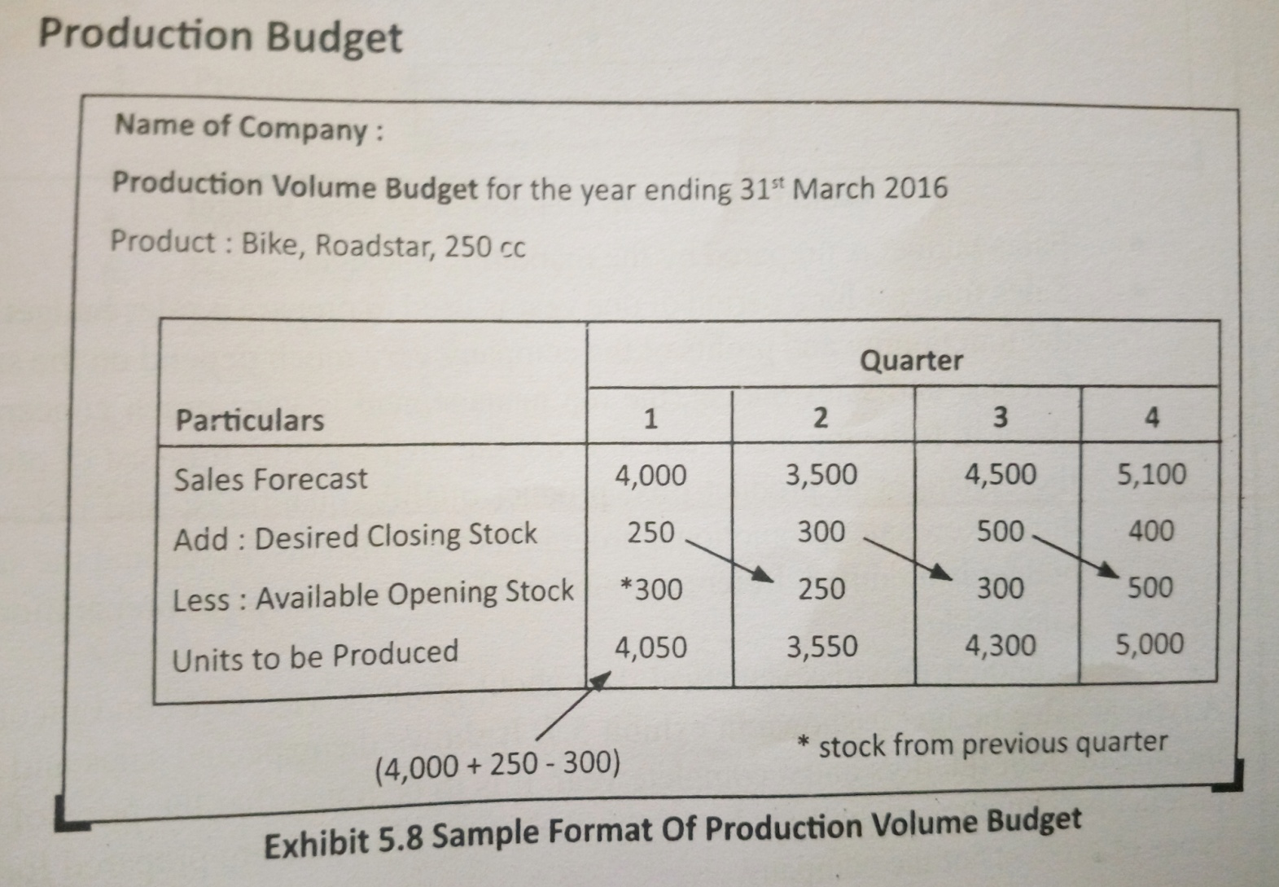
Production Budget

Slide 27
Sales Budget
Provides projections about sales of products in the upcoming year.
Also provides information about income of company.
Market competition and sales forecasting are important inputs
Prepared by marketing manager.
Decides :
  Requirement of advertisement
  Work force required
  Final targets
  Rates of advertisement

Slide 28
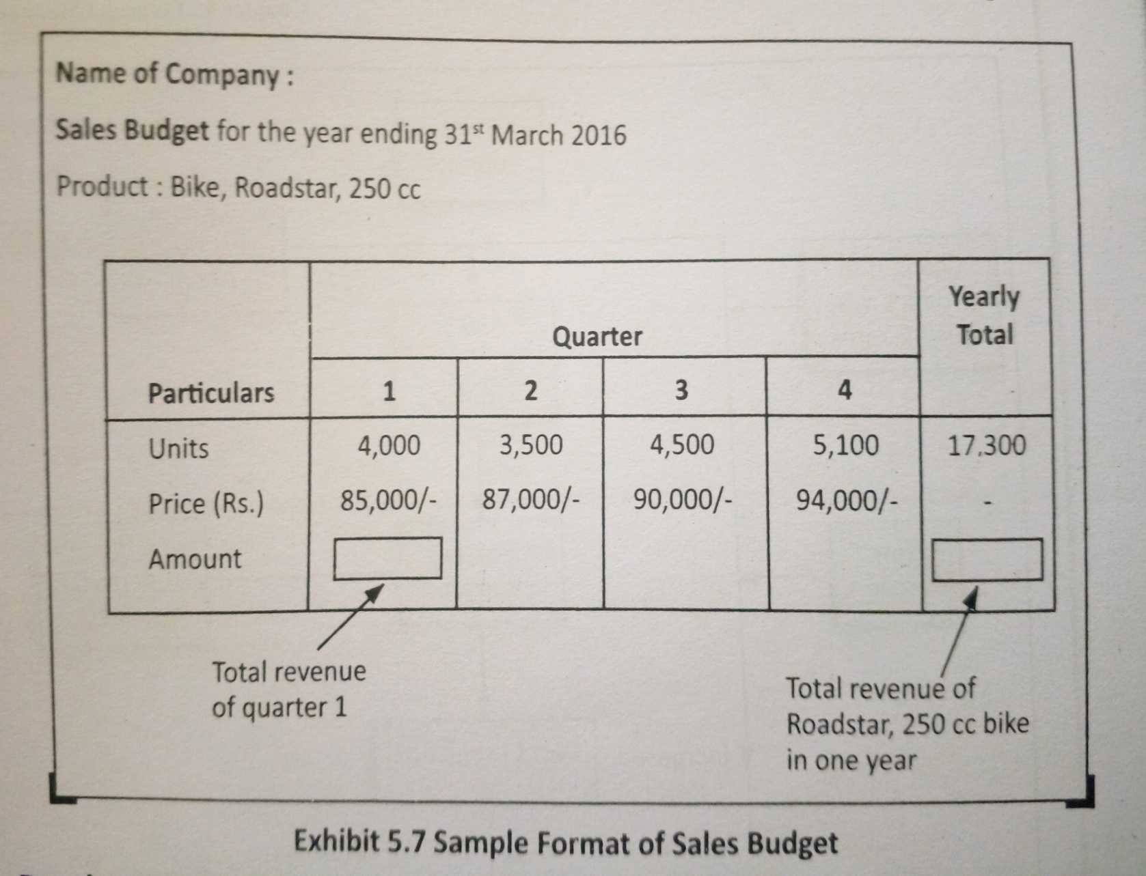

Slide 29
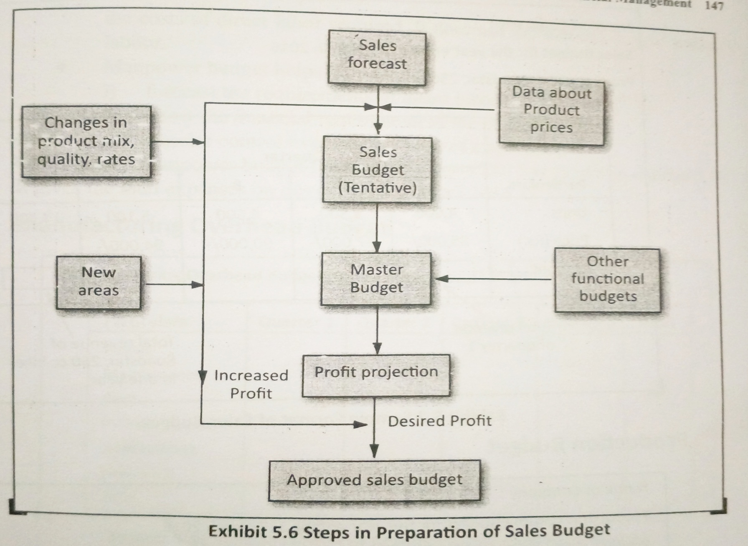
STEPS IN PREPARING SALES BUDGET

Slide 30
Cash Budget
Projects the cash inflow and outflow for a particular time period.
Manages the working capital effectively
Includes:
  Receipts :cash collection from customers
  Disbursement : All cash payments to be done
  Cash surplus or deficit : Shows difference between
  Financing

Slide 31
LABOUR BUDGET
Direct labour : Employees who actually work on machines and produce goods.
Indirect labour: Employees who work indirectly help in production of goods.

Slide 32
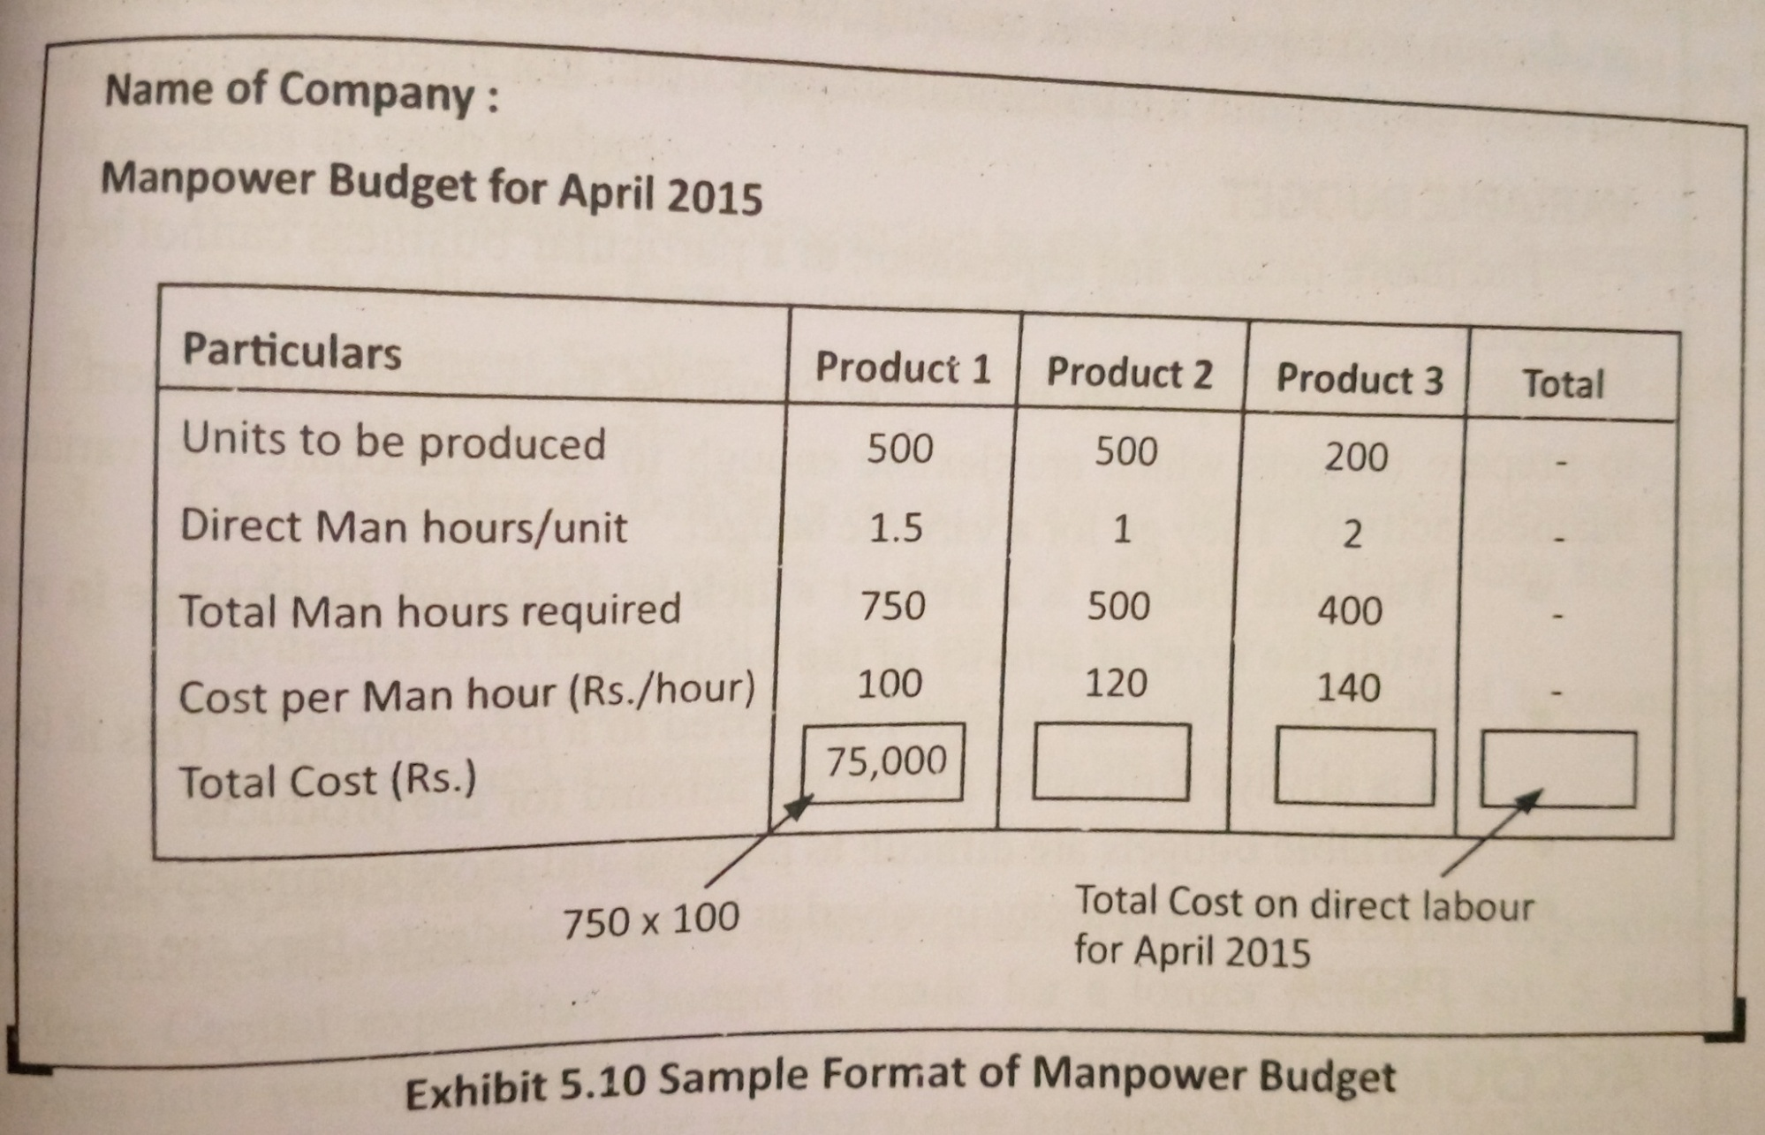

Slide 33
MASTER BUDGET
Summarized budget of entire enterprise
Ensures coordination among departments
Effective control over business
Profit= Total income – total expenses

Slide 34
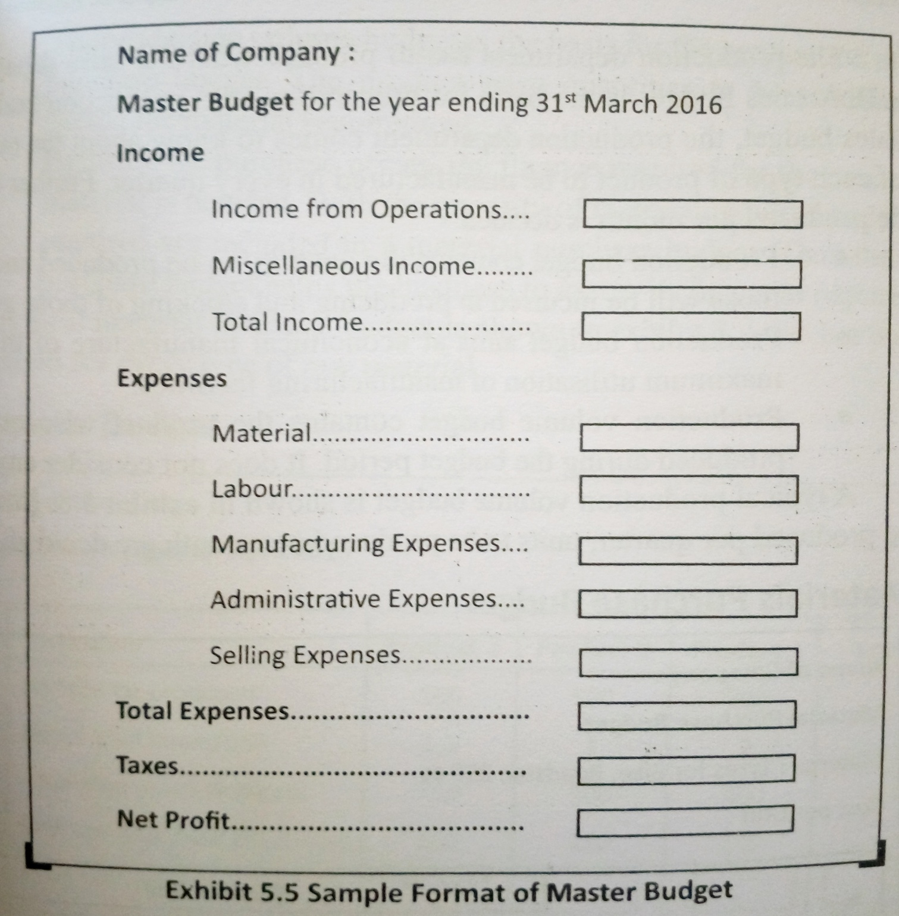

Slide 35
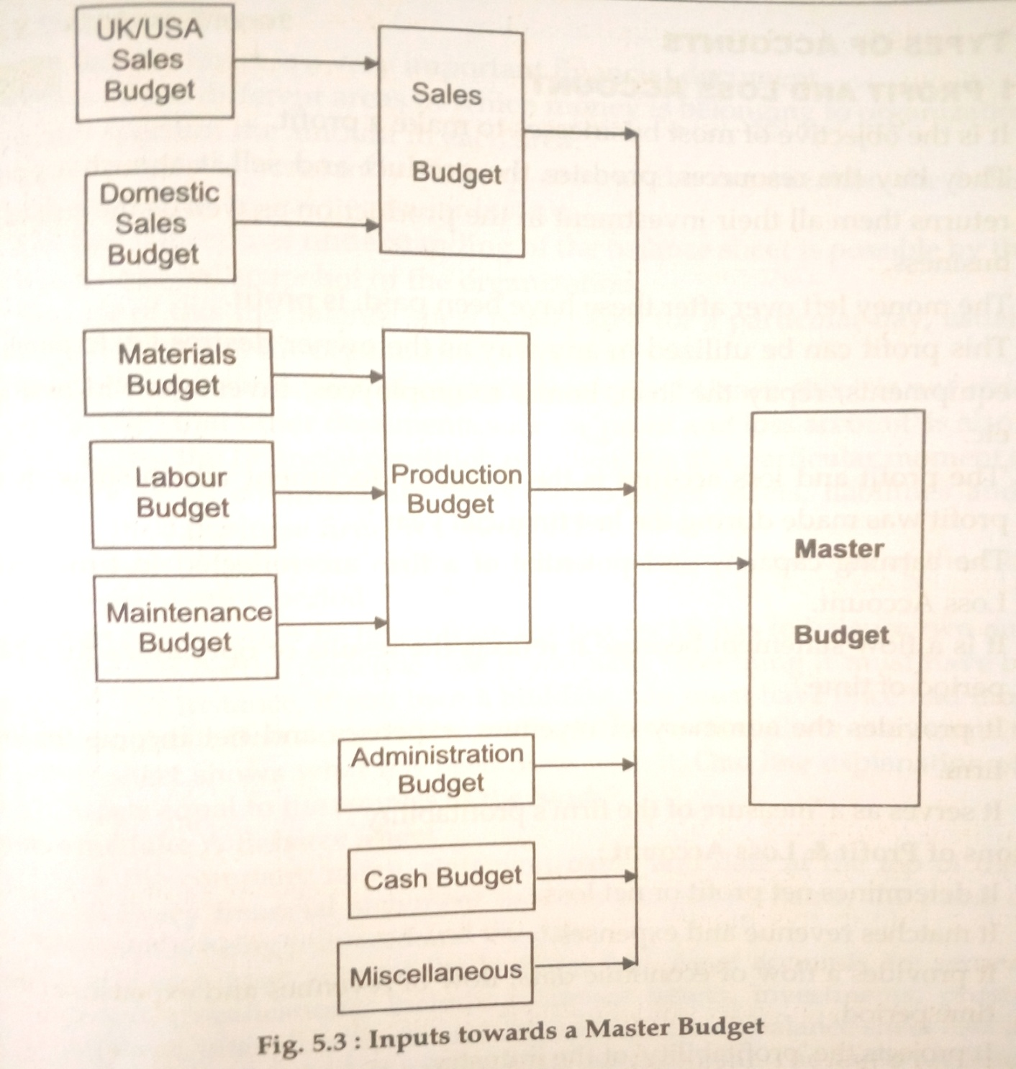

Slide 36
PROFIT AND LOSS ACCOUNTS
Financial document that shows how much profit was made during the last financial year.
Reflects the earning capacity and potential of firm.
Summary of revenues,expensess and net income of firm.
Serves as measure of firms profitability.

Slide 37
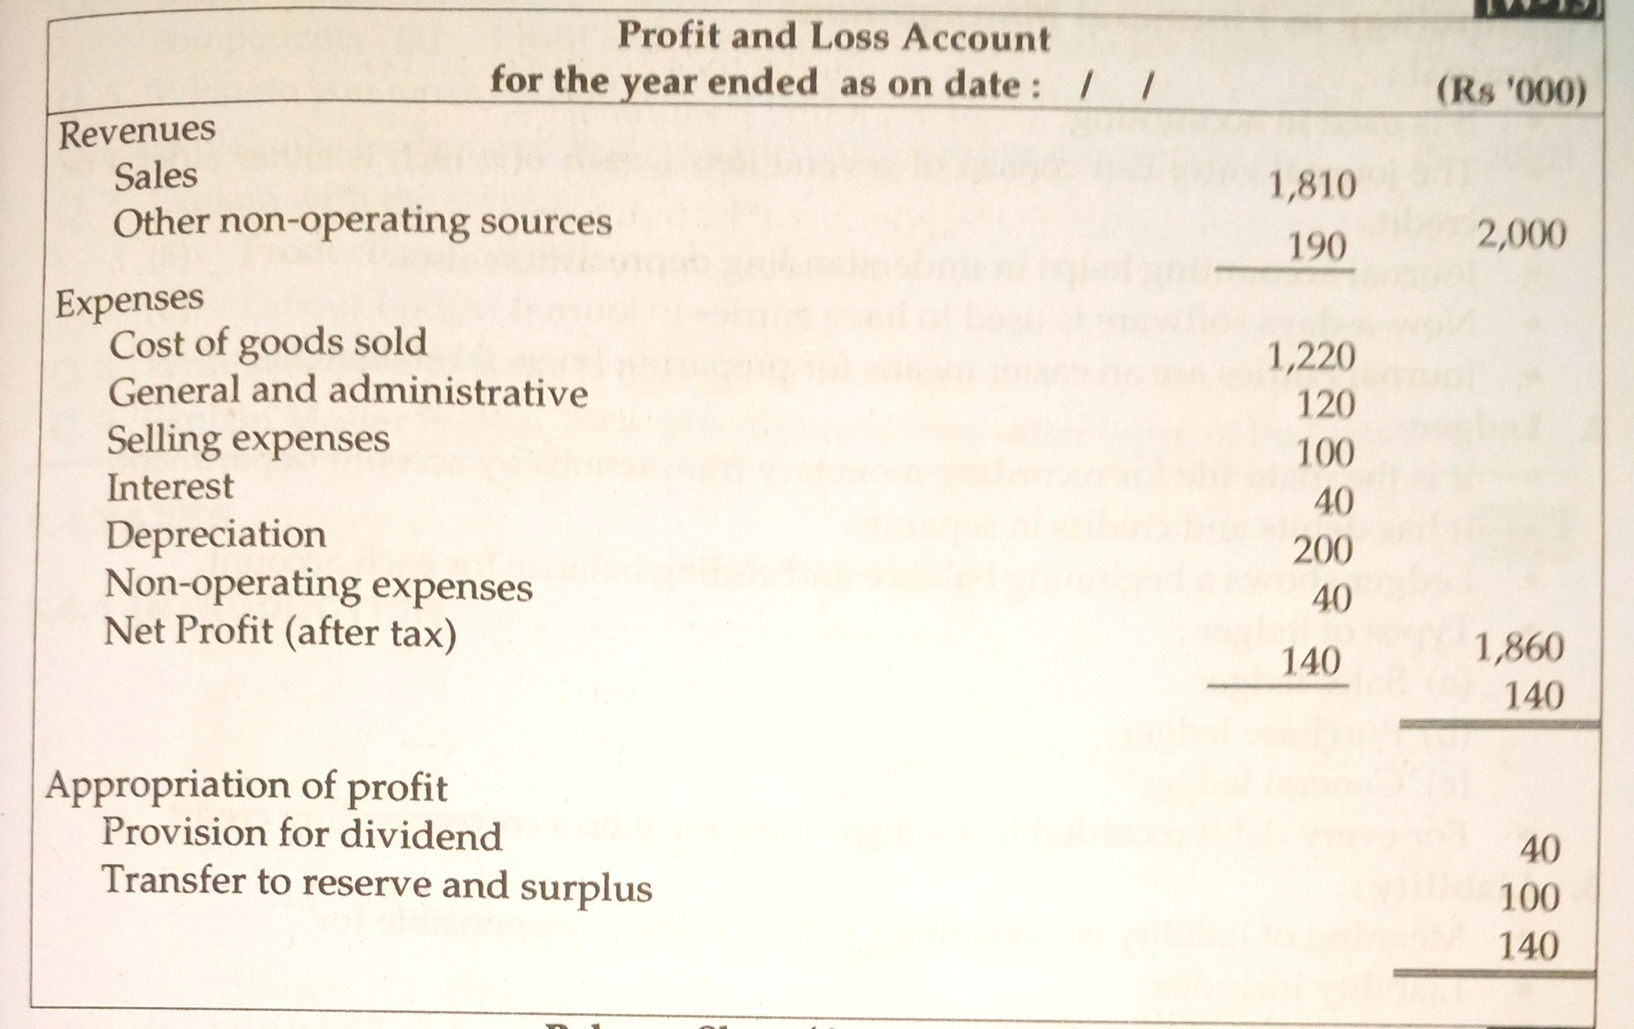

Slide 38
FORMS OF PROFIT AND LOSS ACCOUNT
STEP FORM
Records the revenues first and then the expenses.
Total expenses subtracted from total revenue to get net income/profit.
ACCOUNT FORM
Statement divided in two vertical parts
LHS- record of expenses
RHS-revenues

Slide 39
BALANCE SHEET
Provides the snapshot of firm at that instant.
Shows different areas in which money belongs to organization.
Done on the last day of financial year.
Considers the profit and loss account.

Slide 40
TYPES OF BALANCE SHEETS
ACCOUNT TYPE
Sheet divided in two vertical parts.
RHS- assets or resources of company
LHS-Shows the means by which assets are financed i.e. liabilities or owner’s equity
Total on both sides is equal
REPORT TYPE
A step wise balance sheet is prepared.
Assets are placed at top.
Liabilities and owner’s equity at the bottom

Slide 41
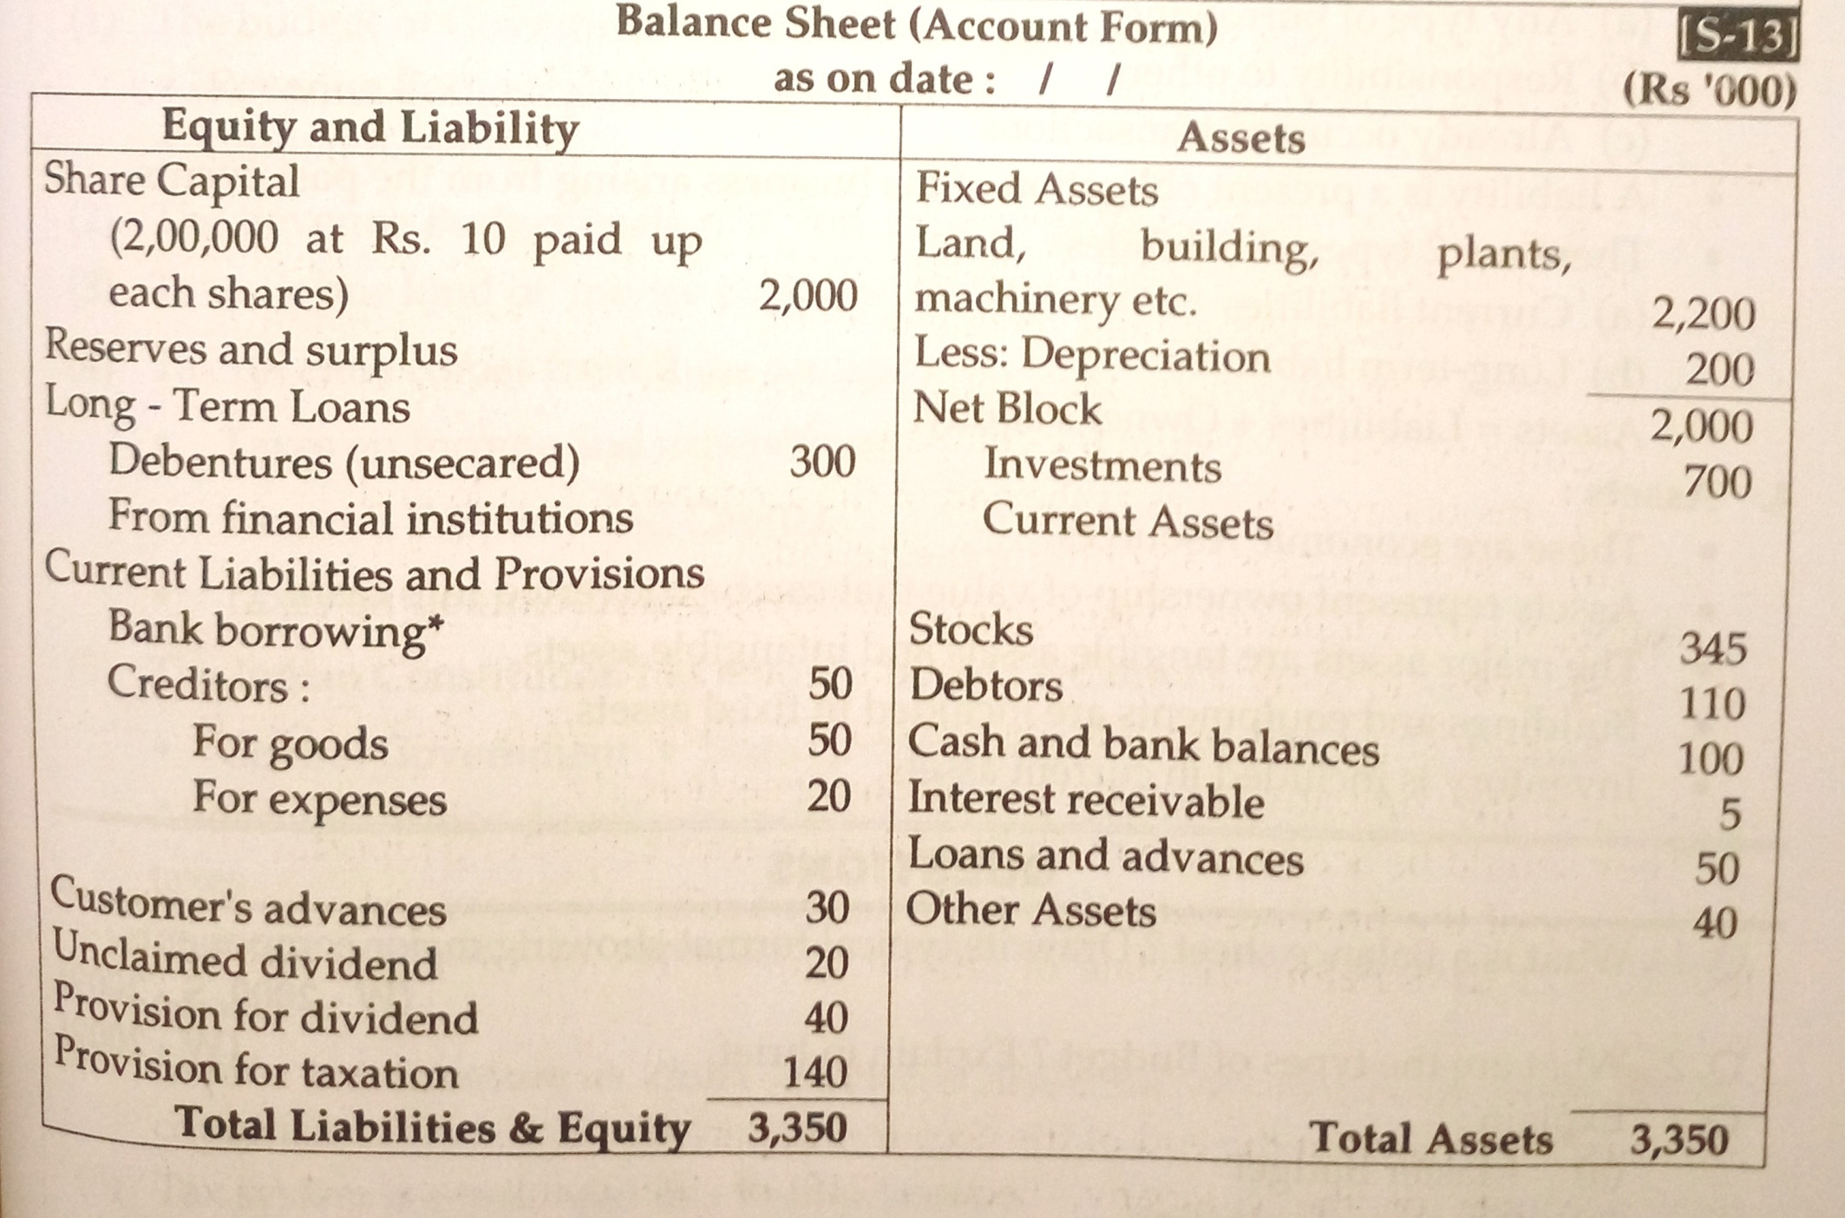

Slide 42
IMPORTANT TERMINOLOGY
Journal: used in accounting for keeping the record either debit or credit
Ledger: Main file that records monetary transactions of accounts department havinf separate debit and credit notes.
Liability: “Someone responsible for something”
  Any borrowing,responsibility
  Assets= liability + owners equity
  Types- 1. Current liabilities 2.Long term liabilities.
Assets: Economic resources ; ownership which can be converted into cash; types -Tangible and intangible assets.

Slide 43
TAXES
  Collection of taxes comes under the Revenue budget of govnt
  It is finance to govnt.
  Following authorities have the authority to collect taxes:
    Central govnt.
    State govnt.
    Local govnt like municipal corporation.

Slide 44
TYPES OF TAXES
TAXES
DIRECT
INCOME
VAT
INDIRECT
EXCISE TAX
CUSTOMS DUTY
SERVICE TAX

Slide 45
DIRECT TAXES
Impact and incidence of the tax is directly on the individual
Eg.:personal income tax, gift tax, estate duty, etc
Has higher degree of elasticity.
Inconvenient to pay ;tax payer feels the pinch
It can be easily evaded ;said as the tax of honesty

Slide 46
DIRECT TAXES
INCOME TAX
Tax on income of individuals
Sources of income:
VALUE ADDED TAX - VAT
Progressive form of sales tax
Tax based upon bill of purchased goods.
CUSTOMS DUTY
Indian Tariff Act 1934 modified into Customs Act 1962
Taxes on Import and export
Levied by Central govnt. And declared as per the Finance Act every year.
Indian Income Tax Act 1922 replaced in 1961
Salary
Business profit
Other income sources
House property
2% education cess on all taxes
Rate of VAT:
4%- goods mfgd from raw materials,IT products and consumable goods
12.5% - listed goods
20% - liquor
1% - gold, silver & precious metals
Exempted – food grains and pulses,milk,vegetables,books
Levied and implemented by Ministry of Finance
Both state and central govnt collects tax
Central govnt levies Customs duties.
Applicable country wide
Third largest revenue generating tax
Tax to be paid on goods imported ; duty paid is charged to the next buyer.
Goods listed in Customs Tariff Act ; ;like vesels ,stored,baggages,currency,moveable property,etc.
Types of customs duties:
Basic customs duty
Additional customs duty
Protective duty
Export duty
Tax to be paid for the past financial year by the rates of next financial year.
Major reforms done in 1991

Slide 47
INDIRECT TAXES
EXCISE TAX
Commodity tax applicable to commodities produced within country
Country divided into 10 zones for administration.
SERVICE TAX
Service sector contribution in GDP is 50% - fastest growing sector
Deposited on monthly or Quarterly basis
Partly collected by State and Central govnts.
Tax on the production of goods like textiles,sugar,tea,cement,etc.
Central Excise Law administered by Central Board of Excise and Customs - C.B.E.C.
Finance Commission decides the share of State and Central govnts.
Tax is ultimately paid by customers.
Applicable to :
Mafg at own level
Mafg by employing hire labour
Mafg through outsourcing to other parties
First started in 1994
Service tax charged on production and sale of goods
Applicable to services in India ; except Jammu and Kashmir
Administered by Central Exsice Department.
Effective Service tax is 12.36% including Education cess
Service Tax No.: 15 digit no allotted to assesse while registration.Banking and finance agencies,real estate agents,
Tax on the final bill / invoice of goods puchased
Applicable to : telephone services,couriers,CA,real estate agents,etc
Expemted to : Small service providers havong turnover < 4 lacs, Export services,Suppliers to SEZ & Services provided to UN

Slide 48
TYPES OF EXCISE DUTY
Basic excise duty in India
ADDITIONAL EXCISE DUTY
Goods listed in Section of Aditional Duties of Excise Actof 1957 are Excisable
SPECIAL EXCISE DUTY
Applicable to all excisable items that come under taxation.
BASIC EXCISE DUTY
Imposed under Section 3 of Central Excises and Salt Act 1944 according to rates that of Central Excise Tariff Act 1985
Applicable to all Excisable gooda except salt
Tax shared between State and Central govnt.
Charged instead of Sales Tax
Finance Act decides the goods that come under this tax

Slide 49
TAXES – IMPORTANT FACTS
CENVAT- Improved form of Central Excise Tax.
  Value added tax
  Paid at the end of mafg of product
  Kelkar Task force on Indirect taxes has recommended that all excise duties to be converted into CENVAT
VAT –
  Haryana was the first state to implement VAT.
  Maharashtra implemented VAT from 1st April ,2005.
  VAT is employed in more than 165 countries.

